Slide 1
Technoprenuership TCP231 Module 10: The PRODUCT or SERVICE
Lecture by: Ashitosh Sah

Slide 2
The Product or Service
Core value of a product or service
Minimum viable product and iterative design
Cost of Goods Sold
Product Development Plan, Gantt Chart

Slide 3
What is a Product?
An article or substance that is manufactured or refined for sale.
Ex: iPhone, furniture, etc.
Every product or service has a purpose
Products are tangible, they can be seen and touched, felt or experienced
There will be Time Gap between production and consumption of goods

Slide 4
PRODUCTS
CONSUMER
BUSINESS
Convenience
Installations
Accessory equipment
Shopping
Raw Materials
Specialty
Component parts
Unsought
Process materials
MRO Supplies
Business Services

Slide 5
Types of Products
CONVENIENCE
PRODUCTS
BUY FREQUENTLY AND IMMEDIATELY
Low priced
Many purchase locations
Includes:
Staple goods
Impulse goods
Emergency goods
SHOPPING
PRODUCTS
BUY LESS FREQUENTLY
Gather product information
fewer purchase locations
Compare for:
Suitability & quality
Price & Style
SPECIALTY
PRODUCTS
SPCIAL PURCHASE EFFORTS
Unique characteristics
Brand Identification
Fewer purchase locations
UNSOUGHT
PRODUCTS
NEW INNOVATIONS
Products consumers don’t want to think about
Require much advertisement and personal selling

Slide 6
What is a Service?
A service is something someone can do for money
Ex: workers
They are not tangible
A major part of service marketing depends on the relationship the marketer/ seller is able to establish with the customer.

Slide 7
Types of Services
The nature of the service providing process
The subject of the service
The nature and function of the service
The company class

Slide 8
Difference between products and Services
Products
Concrete
Tangible
Homogeneous
Product and distribution of goods is separated from consumption
The core value of products is produced in the factory
Can be stored
Transfer of ownership of goods from the manufacturer to the dealer to consumer.
Services
Activity or process
Intangible
Heterogeneous
In services, production, distribution and consumption is simultaneous
Services is produced in the buyer-seller interaction
Impossible to store
Can have access to the service but cannot own it

Slide 9
Difference between products and Services
Products
Products may or may not be perishable
Included intermediaries
Reach consumers through various distribution channels
Inseparable
Easier to market
More control over quality
Quality is an investment
You must solve pain in a repeatable way
Requires upfront capital
Services
Have to be available within time
Offered directly through various sale points
Have to be available at service facility
Separable
More difficult to market
Less control over quality
Quality dictated by budget
Customer decides what they need
Can be started with less capital

Slide 10
Difference in managing a product business and a service business
1. WHO COMES TO WHOM
Products are transported to through distribution channels
Services are location-based
2. STANDARIZATION OR CUSTOMIZATION
Customers like many of their products to be standardized
Customers want most of their services to be customized.

Slide 11
Difference in managing a product business and a service business
3.QUALITY DELIVERY
Quality if product within itself is embedded at the time of manufacture
Qualities that people expect from service includes customization and variation.
4. TANGIBLITY
The products are tangible and can be inspected / sampled before buying
Service on the other hand is experimental and based on a belief

Slide 12
Difference in managing a product business and a service business
5.SCALABILITY
Is scaled up by expanding the manufacturing capacity, distribution and sales reach, and access to more consumers.
It needs a supply of trained service providers and this involves either coaching people from the competitors, induction, training and motivation.
6.OWNERSHIP
A Product can be asset that builds the wealth
A service cannot be owned as is always shown as a expense.

Slide 13
Difference in managing a product business and a service business
7. THE SOURCE OF VALUE
The quality of the products depend on how materials are chosen and converted
The quality of the service depends on how the service providers are selected, trained and motivated.
8. THE ROLE OF SENIOR MANAGEMENT
The process of creating a market-driven design in a product business involves many months of work by expert manpower and managers before the product is produced.
The same process of creating a market driven design needs to happen in front of the customer in few minutes in services

Slide 14
Difference in managing a product business and a service business
9.THE POSITION OF THE CUSTOMER
The customer is outside the manufacturing process
In the service business the consumer is inside the business.
10.THE ROLE OF STANDARIZATION AND MECHANIZATION
Frequently standardized its products. Mechanization is used extensively in the processes.
Asking customer on-line what they desire and then the company tries to deliver it in an individualized manner in real time

Slide 15
THREE LEVELS OF PRODUCT
1. The Core Product
-It is the intangible benefit provided by a product
2. The Actual Product
-It is the tangible and physical benefit of a product
3. The Augmented Product
-It is the extra added service one gets out purchasing a product

Slide 16
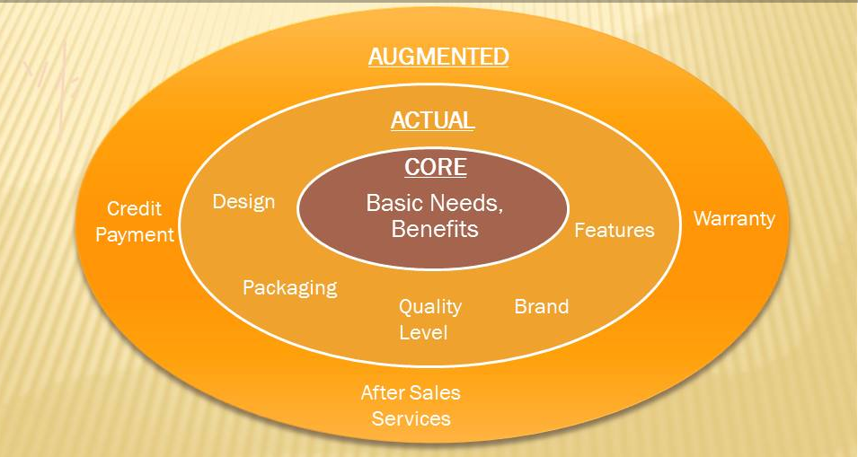

Slide 17

iPhone
The Core Product:
Communication
Messaging
Taking Picture

Slide 18
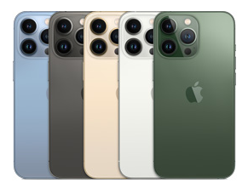
The Actual Product:
Packaging
Ceramic Shield front
Textured matte glass back and
stainless steel design
Weight: 204gram
Features
Super Retina XDR display with ProMotion
6.1‑inch (diagonal) all‑screen OLED display
Pro 12MP camera systemA15 Bionic chip
Brand
Apple is the most trusted brand in the world

Slide 19
Augmented Product:
Delivery
The product can be purchased from any electronic goods showroom. It can be ordered online
Installation
Not required
Warranty
The product has 1 year warranty period
After Sales Services
Can be acquired from any apple service center
Credit / Payment Terms
EMI Facility Available

Slide 20
Core product value represents a solution a real problem that is valuable enough to cause people to want to pay for a product. Core product value is first recognized when the customer connects with the product in an A-Ha moment.

Slide 21
What is a Minimum Viable Product?
A minimum viable product, or MVP, is a product with enough features to attract early-adopter customers and validate a product idea early in the product development cycle. In industries such as software, the MVP can help the product team receive user feedback as quickly as possible to iterate and improve the product.

Slide 22
What is the Purpose of a Minimum Viable Product?
It is the version of a new product that allows a team to collect the maximum amount of validated learning about customers with the least amount of effort.
A company might choose to develop and release a minimum viable product because its product team wants to:
Release a product to the market as quickly as possible
Test an idea with real users before committing a large budget to the product’s full development
Learn what resonates with the company’s target market and what doesn’t
help minimize the time and resources you might otherwise commit to building a product that won’t succeed

Slide 23
Example
Airbnb
With no money to build a business, the founders of Airbnb used their own apartment to validate their idea to create a market offering short-term, peer-to-peer rental housing online. They created a minimalist website, published photos and other details about their property, and found several paying guests almost immediately.
Foursquare
The location-based social network Foursquare started as just a one-feature MVP, offering only check-ins and gamification rewards. The Foursquare development team began adding recommendations, city guides, and other features until they had validated the idea with an eager and growing user base.

Slide 24
Product Development Process
encompasses all steps needed to take a product from concept to market availability.
includes identifying a market need, researching the competitive landscape, conceptualizing a solution, developing a product roadmap, building a minimum viable product, etc.

Slide 25
Who Is Involved in the Process?
product managers typically drive the product development process from a strategic standpoint
requires the work and input of many teams across a business
including: Development, Design, Marketing, Sales, Finance, Testing

Slide 26
Common Flows of the Product Development Process
The Design Thinking Approach
Design thinking is a framework for developing new products based on first identifying a problem or need from the user’s perspective.
The steps involved in the design thinking process are:
Step 1: Empathize with users
Step 2: Define the problem
Step 3: rainstorm potential solutions
Step 4: Build a prototype
Step 5: Test your solution

Slide 27
Common Flows of the Product Development Process
The New Product Development (NPD) Framework
This is a standard, composite approach that businesses often use to develop physical products — as opposed to digital products like software. There are many variations to the NPD framework. Some organizations use a five-step approach, while others break it into as many as eight stages.

Slide 28
Common Flows of the Product Development Process
Here is a common approach that divides the process into six steps:
Step 1: Ideate
Brainstorming, sometimes called the Fuzzy Front-End step, where the team shares all of its innovative ideas.
Step 2: Research
Validating your idea with potential users, and reviewing competitive offerings.
Step 3: Plan
Sourcing suppliers, estimating the production budget, determining how to price your product, etc.

Slide 29
Common Flows of the Product Development Process
Here is a common approach that divides the process into six steps:
Step 4: Prototype
Developing a sample of your finished product to share with key stakeholders. Note: this is different from the minimum viable product, which is for early adopters.
Step 5: Source
Putting together a plan for vendors, materials, and other resources needed to turn the successful prototype into a mass-market product.
Step 6: Cost
Documenting all of the costs required to bring the product to market. This should include line items for manufacturing, materials, setup costs, storage and shipping, taxes, etc.

Slide 30
Gantt Chart
A Gantt chart, or harmonogram, is a bar chart that graphically illustrates a schedule for planning, coordinating, and tracking specific tasks related to a single project.
Henry Gantt, an American mechanical engineer, and social scientist, designed the Gantt chart in the 1910s. Since then, it has been used on major infrastructure projects like the Hoover Dam and the U.S. Interstate Highway System.

Slide 31
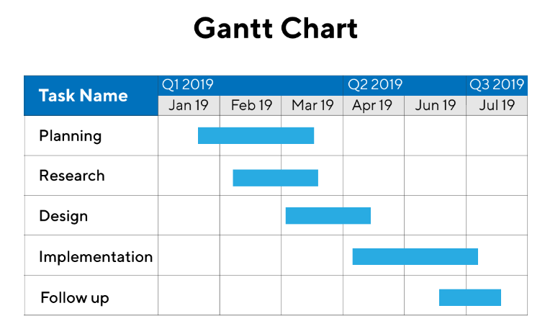

Slide 32


Slide 33
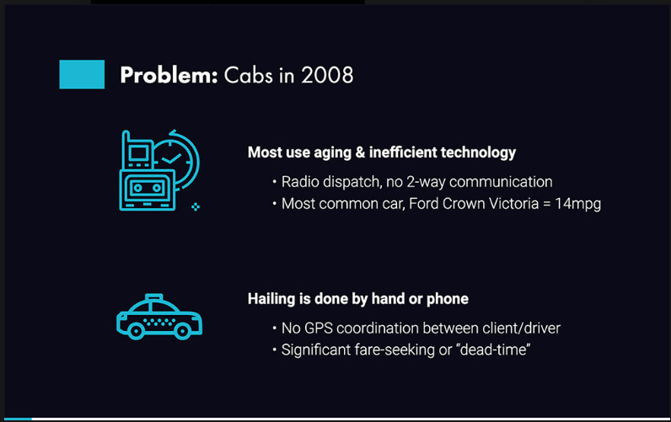

Slide 34
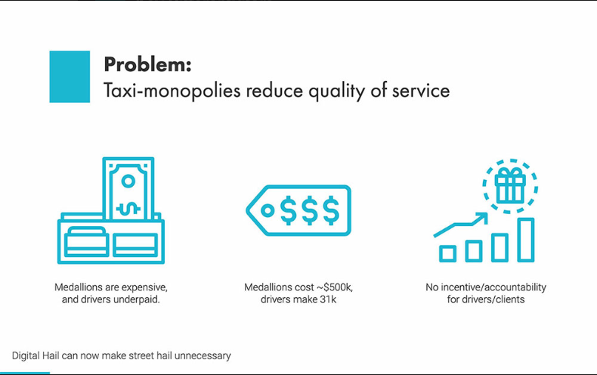

Slide 35
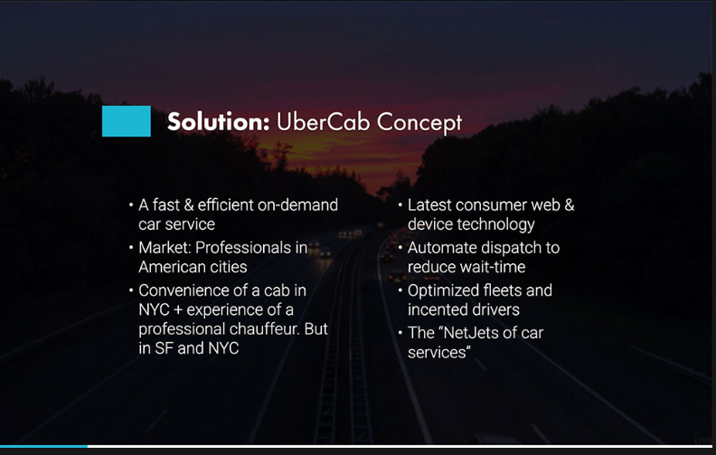

Slide 36
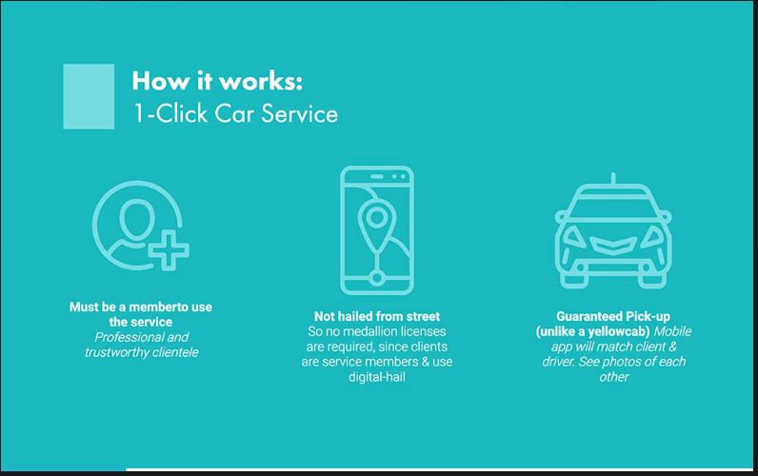

Slide 37
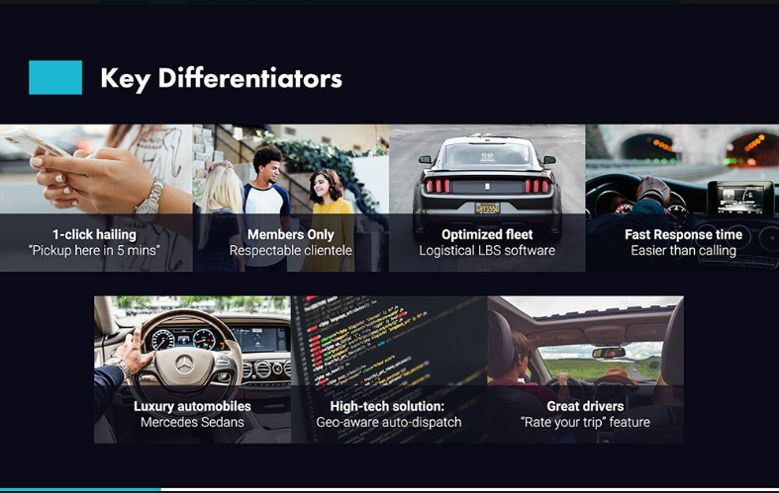

Slide 38
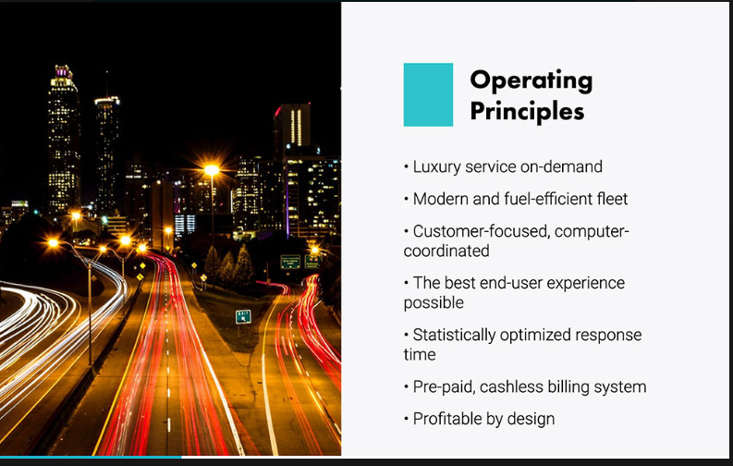

Slide 39
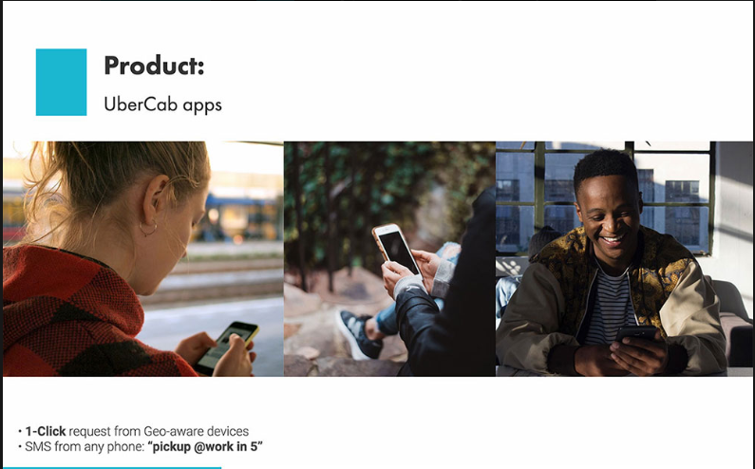

Slide 40
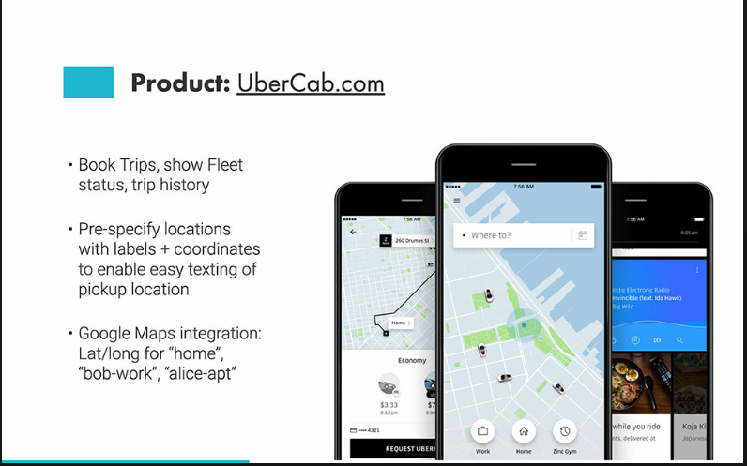

Slide 41
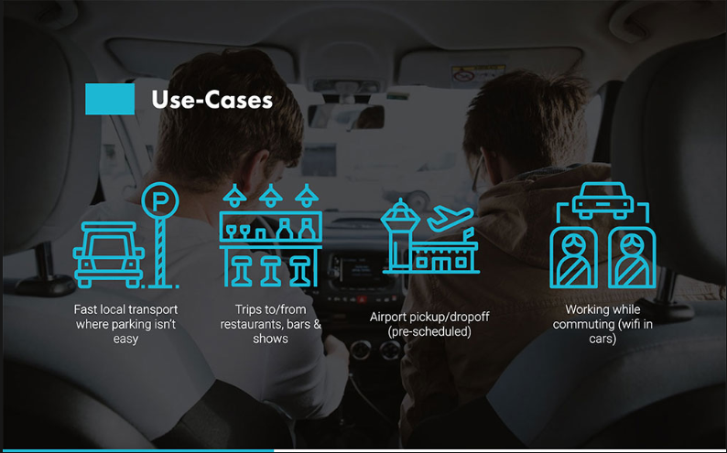

Slide 42
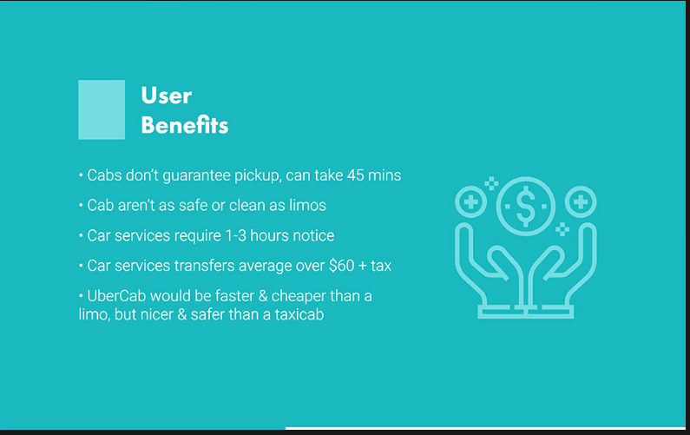

Slide 43
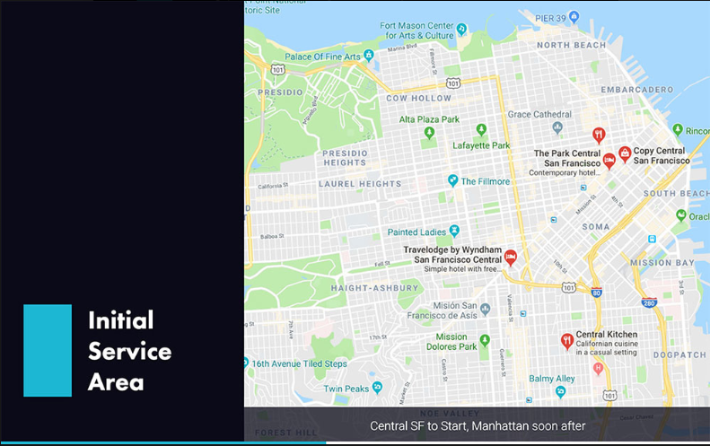

Slide 44
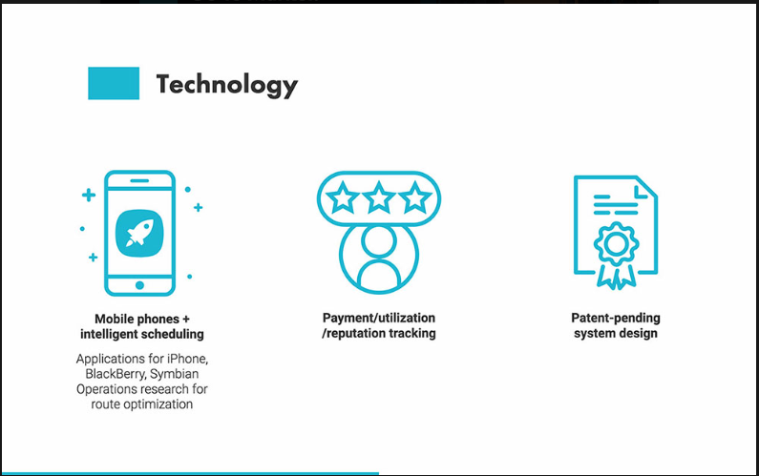

Slide 45
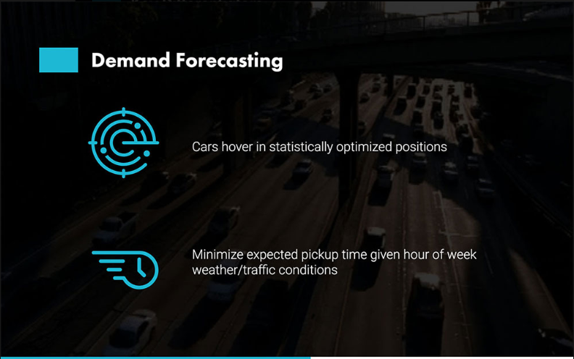

Slide 46
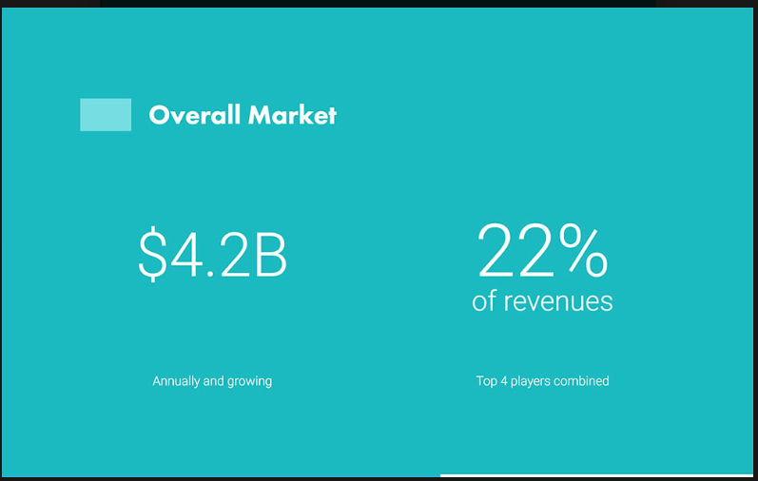

Slide 47
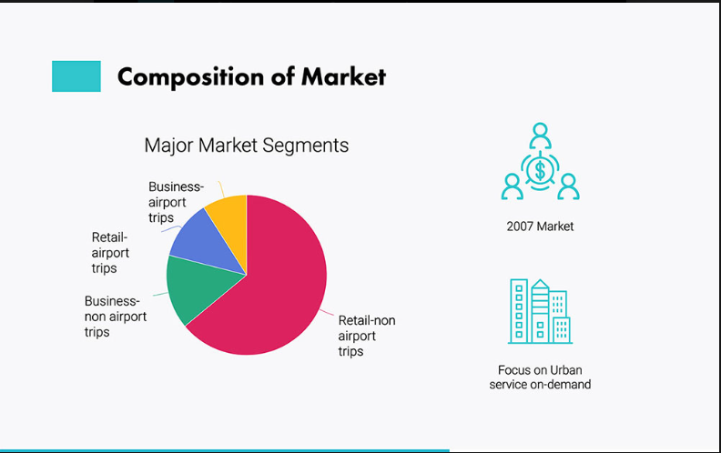

Slide 48
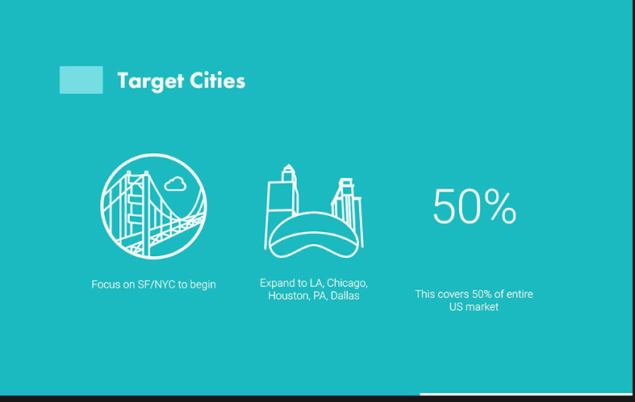

Slide 49
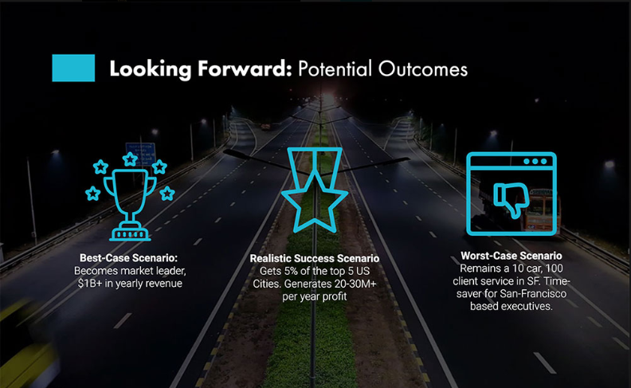

Slide 50
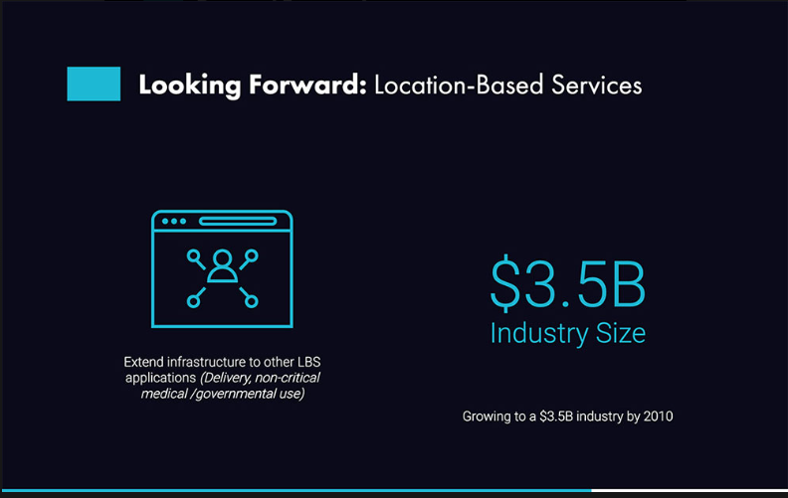

Slide 51
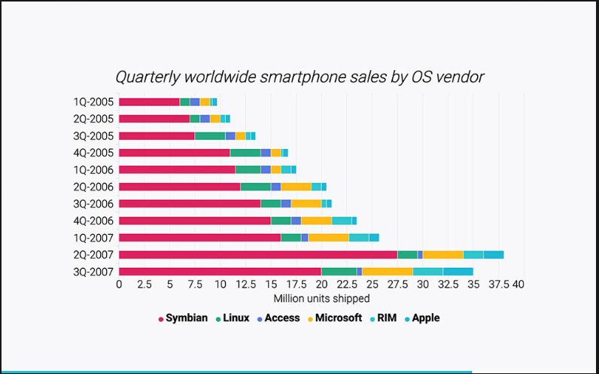

Slide 52
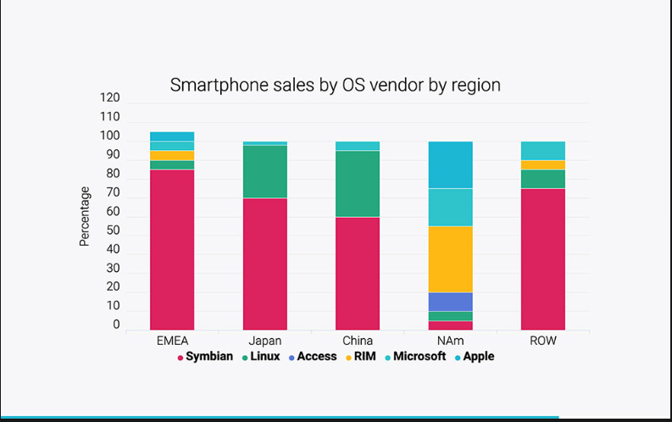

Slide 53
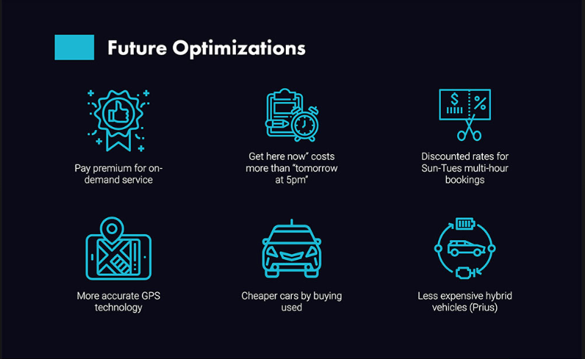

Slide 54
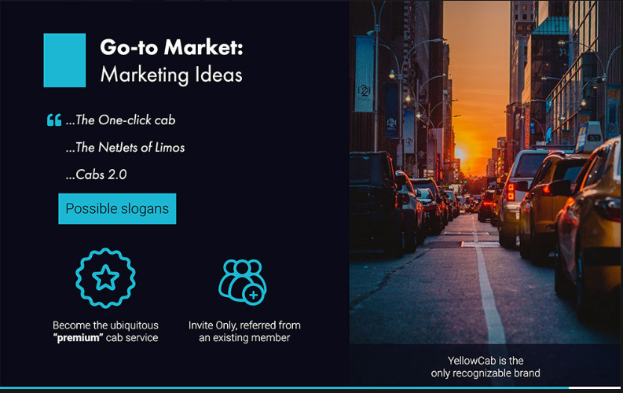

Slide 55
